Slide 1
Peabody Index
Levelling Up London:
Closing the gap for people on low incomes
Greg Windle, Research and Insight Analyst
March 2022

Slide 2
Methods
Macro-economic trends: public data analysed by Learning & Work Institute
Online resident survey
Demographics
Multiple choice on employment, pay, household finances and hardship
Open questions on barriers to employment, experience of Universal Credit

Slide 3
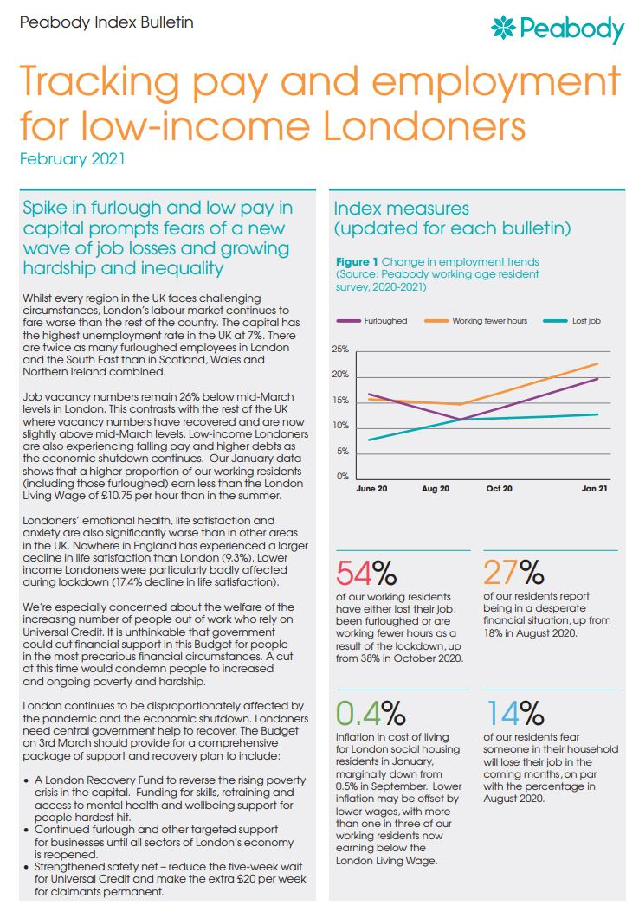
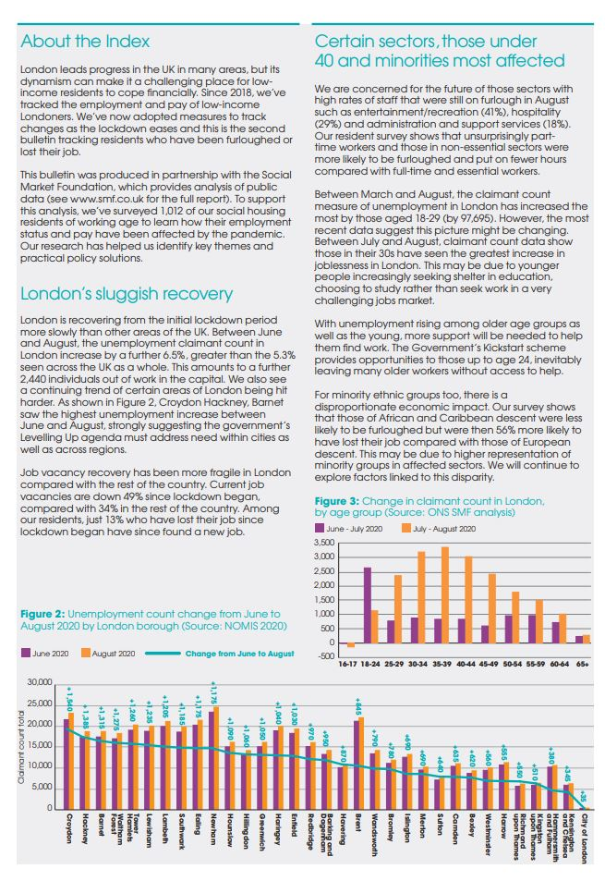
Lockdown bulletins

Slide 4
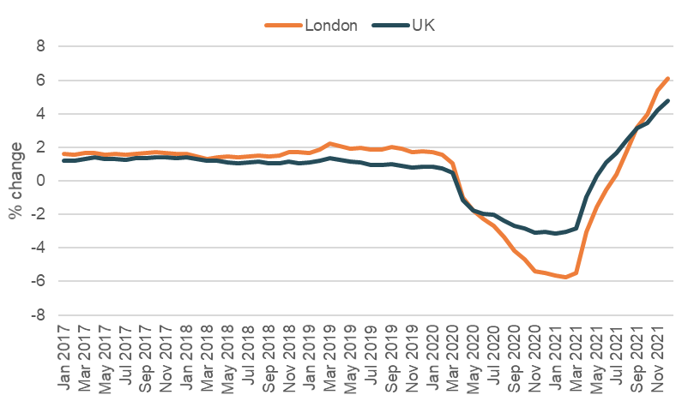
ONS: Regional employee growth - percentage change on same month in previous year, seasonally adjusted, UK, January 2017 to December 2021

Slide 5
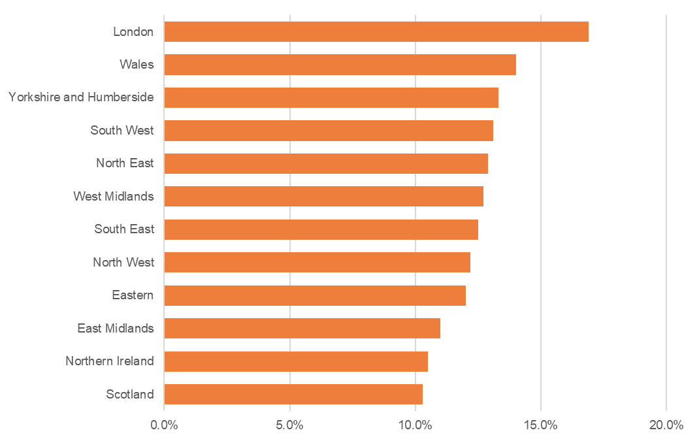
In-work poverty rates by region
Source: UK Poverty 2020-21, JRF, using the Family Resources Survey 2018/19

Slide 6
Contributions to the CPI 12-month inflation rate, UK, December 2019 to December 2021

Slide 7
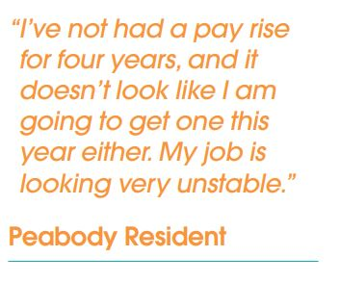
More people feeling worse off
51%
44%
37%%
28%
Source: Peabody Resident Survey

Slide 8
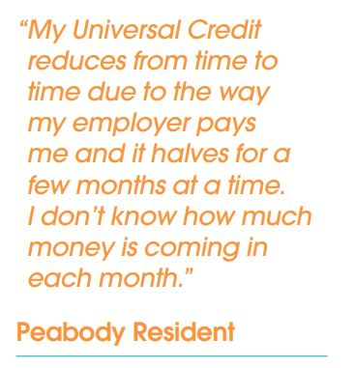
Hardship on the rise among the 37% in a desperate financial situation
65%
53%
47%
40%
Food bank use rose from 7% to 10% of all survey respondents
Source: Peabody Resident Survey, residents reporting being in a desperate financial situation

Slide 9
Following the £20 per week cut to UC

Slide 10
Policy asks
Levelling Up agenda
More specific devolution
Lifetime skills guarantee extension
Safety Net
3.1% increase due next month
Fuel poverty support
Warm Homes Scheme for benefits recipients

Slide 11
Peabody services using Index data
Financial inclusion
Energy advice
Employment
Training

Slide 12
Future research
Fuel poverty
Routes into employment – what works?
Childcare policy and practice

Slide 13
Thank you
Greg Windle
Research and Insight Analyst, Peabody
greg.windle@peabody.org.uk

